Slide 1
COMPUTER VISION FOR REMOTE SENSING
Group 2
48: Shreyash Bhatkar

Slide 2
TABLE OF CONTENTS:
Introduction
Satellite Data
Classification
A brief idea about Remote Sensing and it’s applications
Types,Resources,Applications and challenges
SVM and Random Forest algorithms
CNN
Results
References
Use of CNN for Processing Data
Final output of Processed Data
References used to make this PPT

Slide 3
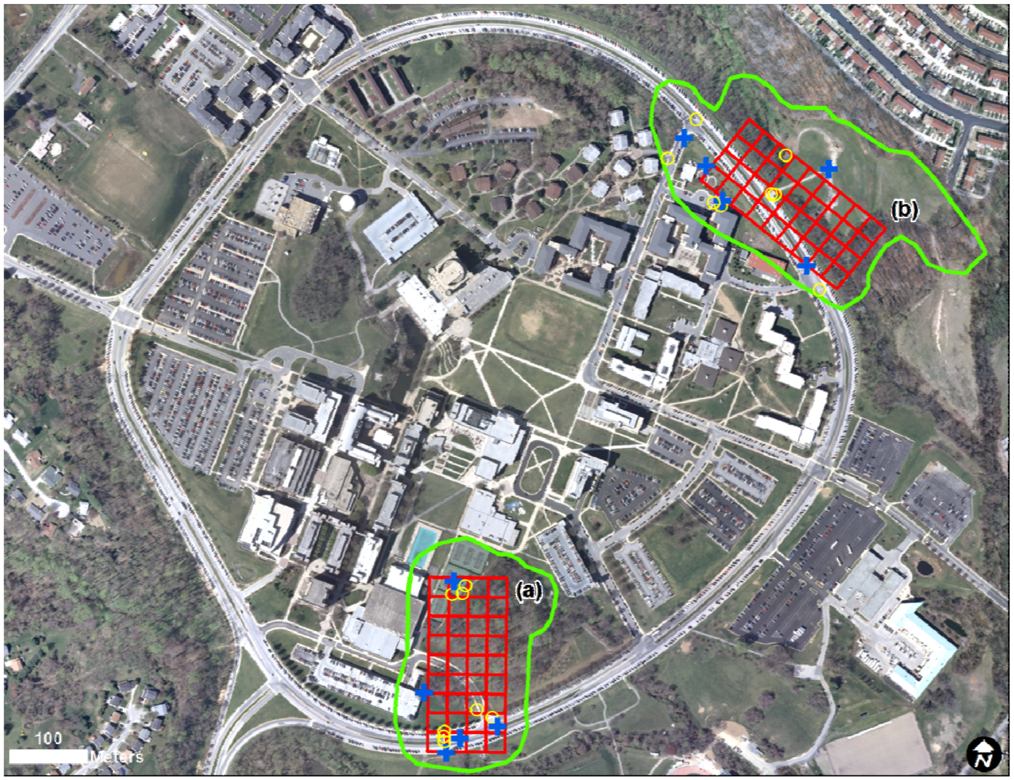
REMOTE SENSING
It is the process of collecting physical characteristics of an area from satellite.
The term is applied specially to acquiring information about the Earth and other planets.
It has ability to collect information over large spatial areas.

Slide 4
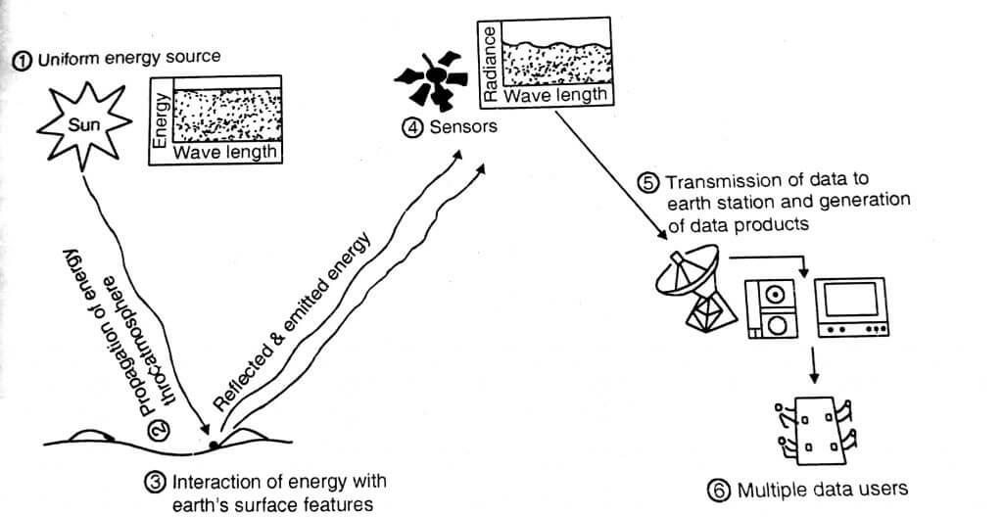
HOW IS DATA ACQUIRED?

Slide 5
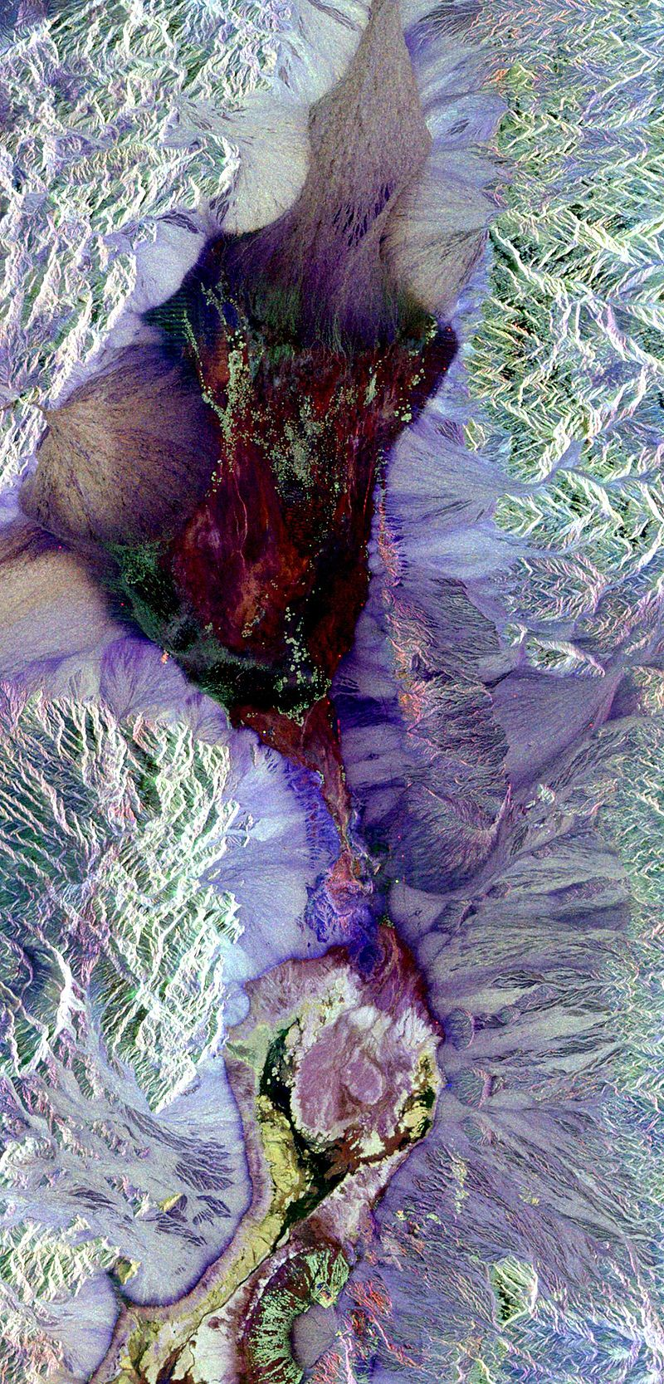
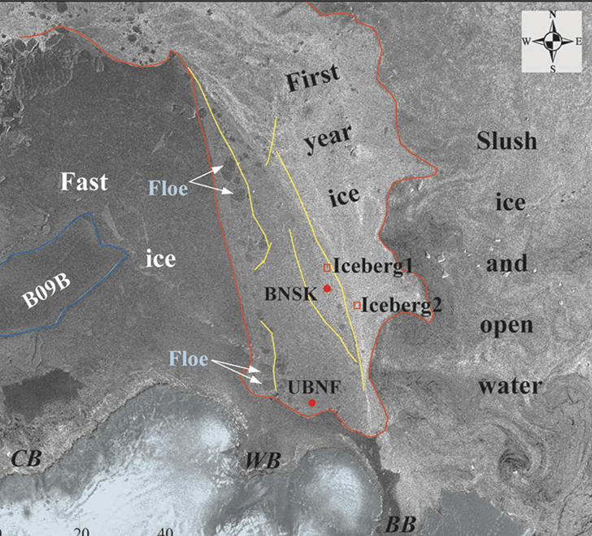
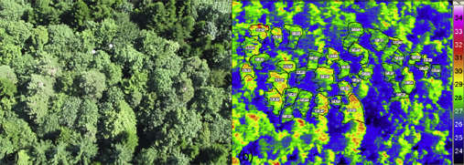
TYPES OF SATELLITE DATA:
Optical
Thermal
Microwave
SAR image of Death Valley colored using polarimetry.
Thermal image with heat mapping.
Locating technique in order to evaluate hidden or embedded objects in a structure.

Slide 6
APPLIATIONS
FIRST
THIRD
FIFTH
Providing base map for Reference
3D GIS and City Models
Agriculture and Forest Satellite
SECOND
FOURTH
Landuse/Landcover Mapping
Application in Mining

Slide 7
CHALLENGES FACED:
Resolution
Weather
Position
AT/OFF Nadir
Inaccurate results due to large distance
Noise due to weather conditions
Image may be over-exposed or under-exposed
Results are inaccurate at off-nadir

Slide 8
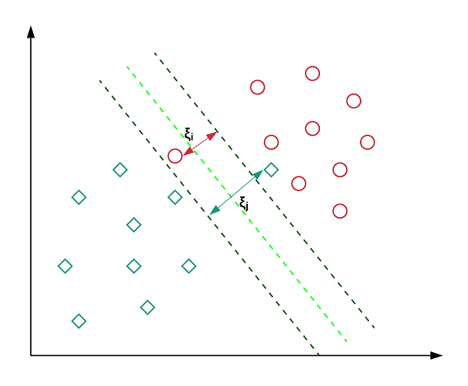
SVM(support vector machine)
It is an algorithm of supervised learning.
It can be used for both regression and classification models
It can solve linear and non-linear problems and work well for many practical problems
Diagram shows how Support Vector machine algorithms work for classification.

Slide 9

RANDOM FOREST:
Random forest is an example of ensemble learning.
It is an algorithm that is based on delicious trees.
It is a supervised learning algorithm used for classification and regression.
Diagram shows Random Forest algorithms work for classification.

Slide 10
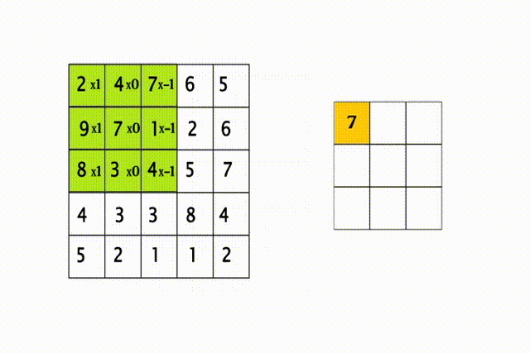
CNN(convolutional nueral network)
Feature Scaling.
Convolution operation.
The steps by which we are moving whole feature detector is called stride.
Feature detector contains tracing until feature map is obtained.

Slide 11
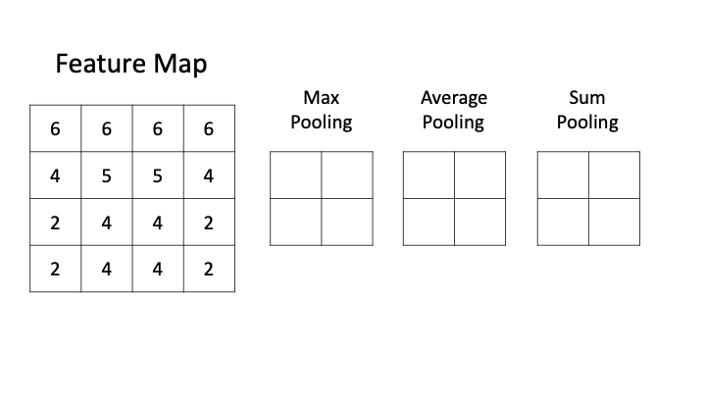
CNN(convolutional nueral network)
Feature map contains important information to be extracted from an image. The exact location of a feature in the image is identified.
RELU activation map is used to introduce non-linearity in operation.
Pooling helps in position invariant object detection.

Slide 12
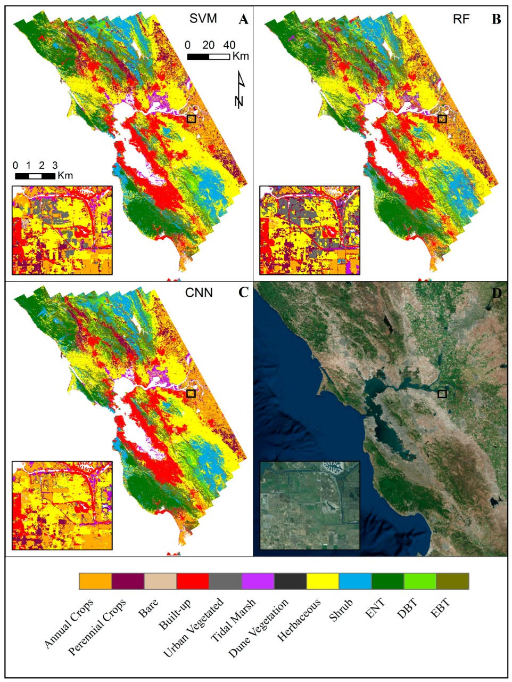
RESULTS
ALOGORITHM | ACCURACY (IN %)
CNN | 94
SVM | 82.33
Random Forest | 74.88
One-Dimensional Convolutional Neural Network Land-Cover Classification of Multi-Seasonal Hyperspectral Imagery in the San Francisco Bay Area, California -

Slide 13
TRIAL TIMELINE
Challenges
CNN
Satellite images (remote sensing) usually contain large amounts of detailed information.
CNN provides neighborhood information as context. It performs the task with 94% accuracy
Challenges
Improvement
It is difficult to classify the objects in image depending only on pixel band values.
CNN performance can further be improved by using CNN and the CNN-RCRF algorithm.

Slide 14
REFERENCES
http://ipco-co.com/PET_Journal/presented%20papers/129.pdf
https://iopscience.iop.org/article/10.1088/1755-1315/20/1/012038/pdf
https://www.youtube.com/watch?v=CQlLa_UWncg&t=321s
https://towardsdatascience.com/land-cover-classification-of-satellite-imagery-using-convolutional-neural-networks-91b5bb7fe808
https://www.youtube.com/channel/UCzwo7UlGkb-8Pr6svxWo-LA
https://www.mdpi.com/2072-4292/13/16/3135

Slide 15
THANKS!
Any questions?

